Slide 1
Introduction to Agile Software Development
Jay Smith – Tyson Foods, Inc.

Slide 2
Agenda
What is Agile?
Agile Manifesto for Software Development
Iterative and Incremental Development
Planning
Requirements
Release
Discussion
Resources

Slide 3
What is Agile?
Notes:
SLOW DOWN, silence is good
Show of hands, who is using some agile practices on your teams? SCRUM, Extremes Programming, Lean
Ok good, so what is agile? WAIT!!!
REPEAT FOR AUDIENCE
Tell SIRAS Story
Sales Information Research and Analysis System for Refrigerated Processed Meats
Small Project – 7 member team
2 developers
High level of interaction with the customers
8 months in length
Was very successful

Slide 4
Manifesto for Agile Software Development
Individuals and interactions over process and tools
Working Software over comprehensive documentation
Customer collaboration over contract negotiation
Responding to change over following a plan
That is, while there is value on the items on the right,
we value the items on the left more.
Notes:
Tell reams of documentation story.
The important thing to understand about the four value statements is that while you should value the concepts on the right hand side, you should value the things on the left hand side even more.
A good way to think about it is that it defines preferences, not alternatives, encouraging a focus on certain areas but not eliminating others.
Does this make sense to everyone, that this is a spectrum, a set of preferences not one or the other?

Slide 5
Iterative and Incremental Development
Back log
Release Plan
Iteration Plan
Iteration
Release
Notes:
Iterative and Incremental Development is at the core of Agile Software Development.
Iterative and Incremental development (IID) has been around longer than you might think.
EVO, short for Evolutionary Project Management, is possibly the oldest with significant agile and adaptive qualities; first taking shape in the 1960’s and published in 1976.
It promoted:
Short iterations
Evolutionary requirements and design
Adaptive client-driven 0r value-driven planning
Quantifiable measurements of value and progress
Defining all quality requirements with numerical measures
Go over slide…

Slide 6
What is a requirement?
A requirement is a statement that identifies a necessary attribute, capability, characteristic, or quality of a system in order for it to have value and utility to a user.¹

Slide 7
User Stories
A user story is a software system requirement formulated as one or two sentences in the everyday or business language of the user.
Simple User Story
As a | [registered user]
I Want to | [log in]
So that | [I can access subscriber content]
Notes:
In agile software development a user story serves the purpose of documenting the requirement.
The user stories should be written by the customers for a software project and are their main instrument to influence the development of the software.
We are not going to do a deep dive into user stories, we will simply define them as a system enhancement defined by the customer. It is similar to a use case in purpose but not in form, it is probably closer to a use case brief.
This is an example of a simple user story
They are usually in the form of AS a [role], I want to [ACTION], so that [VALUE]

Slide 8
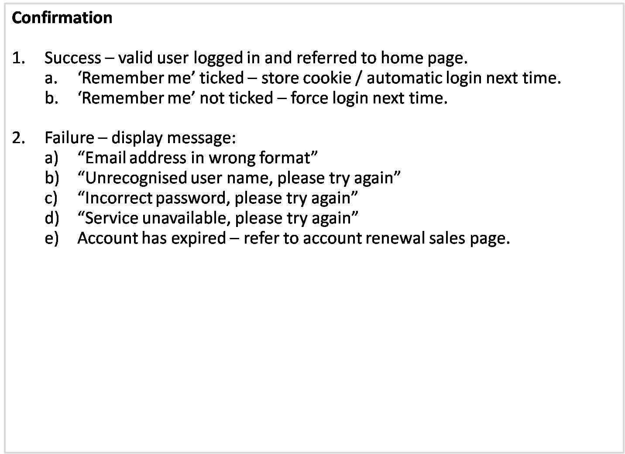
User Stories
Back
Notes:
What is a requirement?
SLOW DOWN, silence is good
REPEAT FOR AUDIENCE

Slide 9
Tools for Planning
Release Plan - The release plan is a list of customer prioritized task from the backlog that must be in the next release of the software.
Iteration Plan - The iteration plan is a list of customer prioritized task from the current release plan that should be completed in the current iteration.
Notes:
Both of these are project task that involve the whole team. Whole team is another concept of Agile teams. Whole team includes the Project Manager, Business Analyst, Developers, Testers, and most important the customer or the Product owner.
It is also important to note that members of the team may play more than one role during an iteration. So someone that codes may also work on driving more details on user stories as well. Everyone has input, everyone is involved.

Slide 10
The Iteration
Planning
The iteration plan is constructed to identify items that should be developed in this iteration
Analysis
User Stories in this iteration are further detailed to a level required for the developers to work, acceptance criteria is defined
Design
The design is also flushed out to identify any refactoring that may need to occur
Develop
Where the magic happens….
Test
This includes, unit, integration, and user acceptance testing
Notes:
An iteration is a short, small scope loop through a full software life cycle. You could look at it as a trip through a mini waterfall.
Planning here is how you are going to plan your work for the current iteration.
The User Stories for the current iteration are broken down to detail task and acceptance criteria for each of them is defined. These are used in testing to determine has the requirement been meet
Design and Development are done simultaneously in some cases, and here design is used more to talk about the design of the code, applying good Object Oriented Principles, Design Patterns, etc. Creating agile code.

Slide 11
The Iteration Board
User Stories | Active Tasks | Completed Tasks

Slide 12
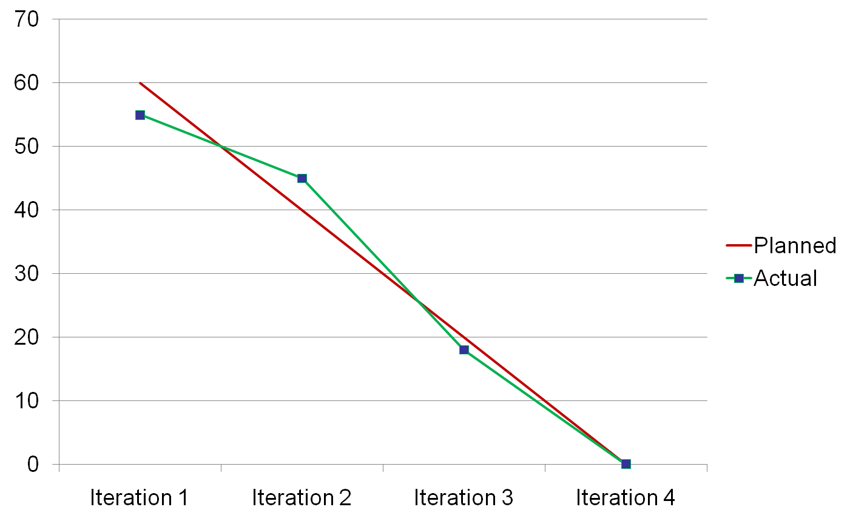
The Burndown Chart
Remaining Effort
Notes:
The burn down chart is an awesome tool for monitoring the progress of the project.

Slide 13
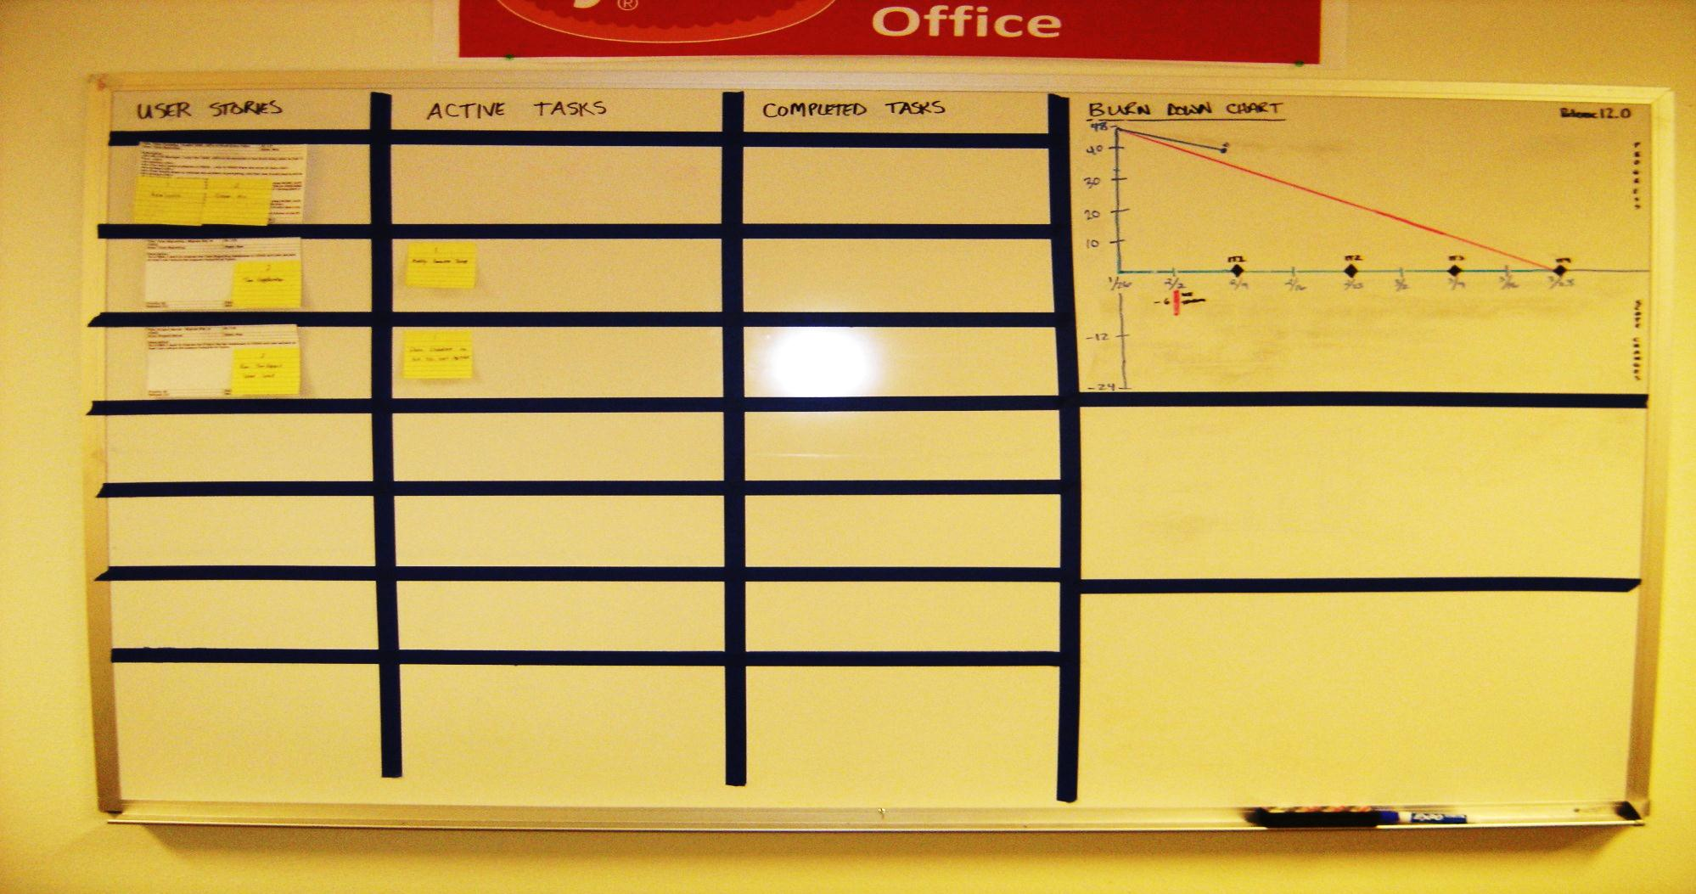
The Iteration Board

Slide 14
Working Software Is Released!
Notes:
We have gathered our requirements,
Planned our releases,
Planned and the current iteration,
We are at the end of the iteration and our customers have accepted the code, so next we need to deploy our changes.
Here is where Agile gains a lot of interest over waterfall, we have just delivered value to our customer, functionality that they can use and benefit from right now.
Remember this is every 1 – 6 months not years.
If the project was stopped at this point we have already delivered value to our client
Are we done?
No, we have several more releases to work through to get all the features implemented.
I mentioned done, finding out when a project is done is a problematic regardless of the project approach.
How do you determine done on your projects today?
You determine done in an agile project the same ways you do in a waterfall project.
All of the features have been implemented
You run out of money
You run out of time, or the customer call it off

Slide 15
Review
Requirements are collected at a high level, user story or use case brief are created and placed on the backlog
The team and the customer collaborate on items on the backlog and organize them into releases
Each release is further broken down into iterations
Each iteration goes through a full life cycle; Planning, Analysis, Design, Develop, and Test
Working software is release often on shorter cycles delivering value to the customer often
Notes:
We have gathered our requirements,
Planned our releases,
Planned and the current iteration,
We are at the end of the iteration and our customers have accepted the code, so next we need to deploy our changes.
Here is where Agile gains a lot of interest over waterfall, we have just delivered value to our customer, functionality that they can use and benefit from right now.
Remember this is every 1 – 6 months not years.
If the project was stopped at this point we have already delivered value to our client
Are we done?
No, we have several more releases to work through to get all the features implemented.
I mentioned done, finding out when a project is done is a problematic regardless of the project approach.
How do you determine done on your projects today?
You determine done in an agile project the same ways you do in a waterfall project.
All of the features have been implemented
You run out of money
You run out of time, or the customer call it off

Slide 16
Resources
Extreme Programming - http://www.extremeprogramming.org/
Scrum - http://www.controlchaos.com/
The Agile Manifesto for Software Development
- http://agilemanifesto.org/
My Blog – http://jaysmith.us
My Email – jay@jaysmith.us
Additional Resources - http://delicious.com/jay.smith/agile
Notes:
We have gathered our requirements,
Planned our releases,
Planned and the current iteration,
We are at the end of the iteration and our customers have accepted the code, so next we need to deploy our changes.
Here is where Agile gains a lot of interest over waterfall, we have just delivered value to our customer, functionality that they can use and benefit from right now.
Remember this is every 1 – 6 months not years.
If the project was stopped at this point we have already delivered value to our client
Are we done?
No, we have several more releases to work through to get all the features implemented.
I mentioned done, finding out when a project is done is a problematic regardless of the project approach.
How do you determine done on your projects today?
You determine done in an agile project the same ways you do in a waterfall project.
All of the features have been implemented
You run out of money
You run out of time, or the customer call it off

